Slide 1











SRM
UNIVERSITY
Search . . .
LIBRARY MANAGEMENT
SYSTEM
PYTHON
First Presentation - Project Overview

Slide 2
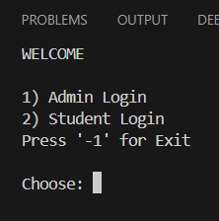

SRM
UNIVERSITY
Search . . .
INTRODUCTION
A Python-based library management system with a MySQL backend.
To manage library books and student records efficiently.

Slide 3

SRM
UNIVERSITY
Search . . .
SYSTEM MODULES
01
DATABASE CONNECTION
Our system connects to a MySQL database, which stores all the data related to books and student transactions.
02
ADMIN PANEL
The Admin Panel is where all administrative tasks are performed. This includes viewing all issued books, editing book records, and managing student information
03
STUDENT PANEL
The Student Panel provides students with options to issue new books, return books they have borrowed, and view the books currently issued under their name

Slide 4



SRM
UNIVERSITY
Search . . .
MYSQL INTEGRATION
DATABASE CONNECTION
ERROR HANDLING
DATABASE MANAGEMENT
The system connects to MySQL using Python's mysql.connector module.
The system prompts the user for corrections and provides instructions for fixing common issues.
If the specified database does not exist, the program automatically creates it and sets it up for use

Slide 5
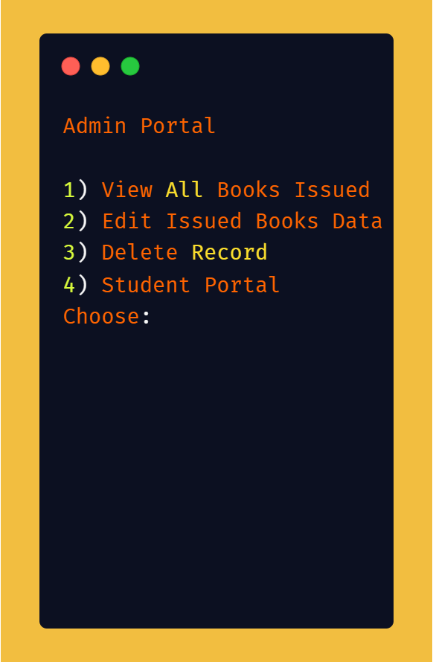
SRM
UNIVERSITY
Search . . .
USER INTERFACES
ADMIN PANEL
View All Issued Books: Administrators can see a list of all books currently issued, along with the student details.
Edit Book Data: Administrators can edit the data associated with a book, such as updating the book ID or student information.
Delete Records: The admin has the ability to delete records of returned books or incorrect entries.

Slide 6
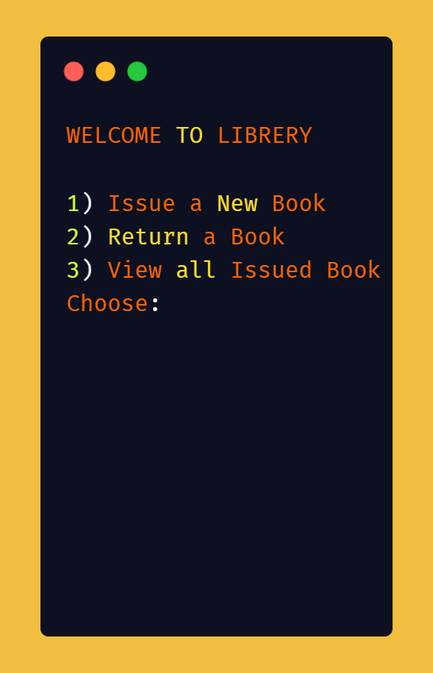
SRM
UNIVERSITY
Search . . .
USER INTERFACES
STUDENT PANEL
Issue a New Book: Students can issue a new book by providing their student ID and the book’s unique code.
Return a Book: Students can return a previously issued book by confirming their student ID and the book ID.
View Issued Books: Students can view a list of all books they have currently issued.

Slide 7
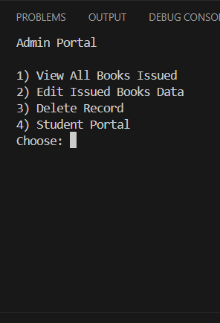
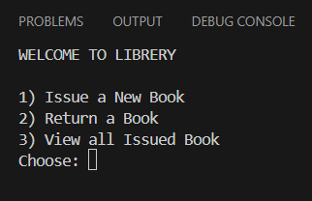
SRM
UNIVERSITY
Search . . .
PROGRAM FLOW
01
USER SELECTION
02
ADMIN PANEL FLOW
03
STUDENT PANEL FLOW

Slide 8
SRM
UNIVERSITY
Search . . .
PROGRAM FLOW
01
USER SELECTION
The program begins by displaying a welcome screen where the user is prompted to select their role:-
Admin Login
Student Login
Users also have the option to exit the program.

Slide 9
SRM
UNIVERSITY
Search . . .
PROGRAM FLOW
02
ADMIN PANEL FLOW
The Admin Panel allows the admin to:
View All Issued Books: Displays a list of all books currently issued to students.
Edit Issued Books Data: Allows the admin to update records if needed (for example, correcting a Book ID).
Delete Record: The admin can remove a student's issued book record from the database.

Slide 10
SRM
UNIVERSITY
Search . . .
PROGRAM FLOW
03
STUDENT PANEL FLOW
The Student Panel provides the following options:
Issue a New Book: The student enters their ID and the book’s UPC code to issue a book.
Return a Book: The student can return a book by entering their ID and the Book ID.
View All Issued Books: Students can check which books they have currently issued.

Slide 11
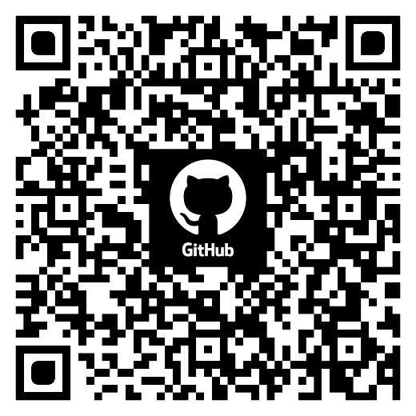
SRM
UNIVERSITY
Search . . .
UPCOMING WORK
NEXT STEPS
Feature Implementation: We will add more features to enhance the functionality of the system,
Testing and Debugging: We will continue testing the system to ensure it is robust and free from bugs.
Final Presentation: Prepare for the final presentation where we will demonstrate the complete system and submit the documentation.

Slide 12
SRM
UNIVERSITY
Search . . .
CREDIT & TEAM CONTRIBUTIONS
422
423
442
444
Ashish GARG
Vaibhav singh
vansh singh
Piyush singh
Programming
MySQL Integration
Interface Design
Admin & Student Panel Development
Special Thanks
We would like to extend our gratitude to our professors and peers for their guidance and support throughout this project.

Slide 13

SRM
UNIVERSITY
Search . . .
CONCLUSION & Q&A
Summary:
In this presentation, we have provided an overview of our Python Library Management System, including its key modules, MySQL integration, and user interfaces. We have also outlined the program flow and credited the team members for their contributions.
Q&A:
We welcome any questions or feedback from the audience.
Thank you for your attention!

Slide 14

SRM
UNIVERSITY
Search . . .
THANK YOU
SEE YOU SOON

